Slide 1
Outcomes over Outputs
Measure what matters to the business

Slide 2

Laksh Ranganathan
Sr Manager, Product Operations @ Tasktop Technologies
Laksh’s roles have spanned the value stream from engineering to product management to consulting across multiple industries. In her current role, among other things, Laksh focusses on optimizing flow of value across Tasktop’s own Product Value Streams
Notes:
I am Laksh Ranganathan

Slide 3

Not everything that can be counted counts
- William Bruce Cameron
Notes:
How many of us have been asked at one time or the other to provide a particular metric by our bosses, CEOs, snr managers?
So how do we determine what to measure?

Slide 4

How’s Sam doing?

Slide 5
It depends…

Slide 6
It depends…..
Fitness
Great

Slide 7
It depends…..
Marathon next week
Not as great

Slide 8
It depends…..
Climb Kilimanjaro
Not Sure

Slide 9
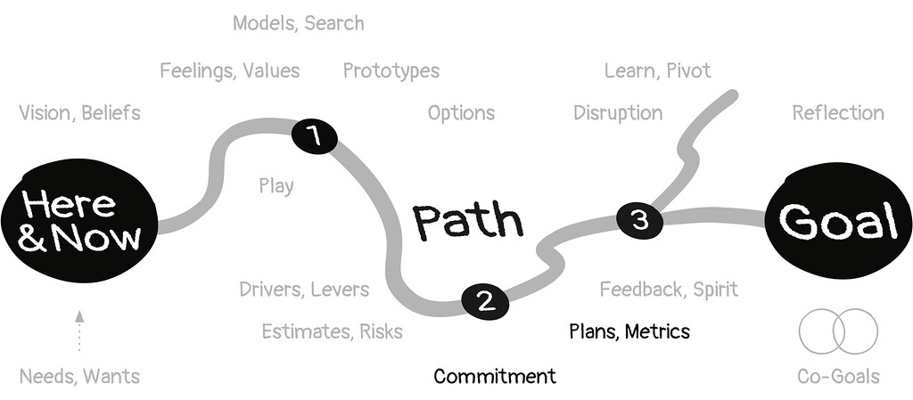
What is the goal?
What questions does the business need answering
This Photo by Unknown Author is licensed under CC BY

Slide 10

Organization structures are hierarchical

Slide 11




Optimized for teams and functions
Planning
Operations
Development
Release
Testing

Slide 12

Metrics reflect team / functional context
Burn up /
Burn down
charts
MTTR
Planning
Operations
Story points
delivered
Deploys per day
Development
Release
Defect Ratio
Testing

Slide 13
Business cares about
Satisfying customer demands
Investment generating most value for customers
Value delivered to customers

Slide 14
Focus on Customers
Satisfying customer demands
Investment generating most value for customers
Value delivered to customers
Notes:
The focus here is the customer
The Question that comes up often is that how do you measure the Value delivered to customers. It is hard and varies vastly depending on what you are speaking about

Slide 15
Value delivery transcends teams and functions
Planning
Operations
Development
Release
Testing
Notes:
Value transcendas teams and functions in the sense that to be able to tracke the delivery, you need to look at it end to end across the value streams.

Slide 16
Value delivery transcends teams and functions
Ideate
Create
Release
Operate
Planning
Operations
Development
Release
Testing
Notes:
Track the value from request to release from a customers perspective
You can only do that when you look at all the work within IT with a Product lens and viewing it as a value stream

Slide 17
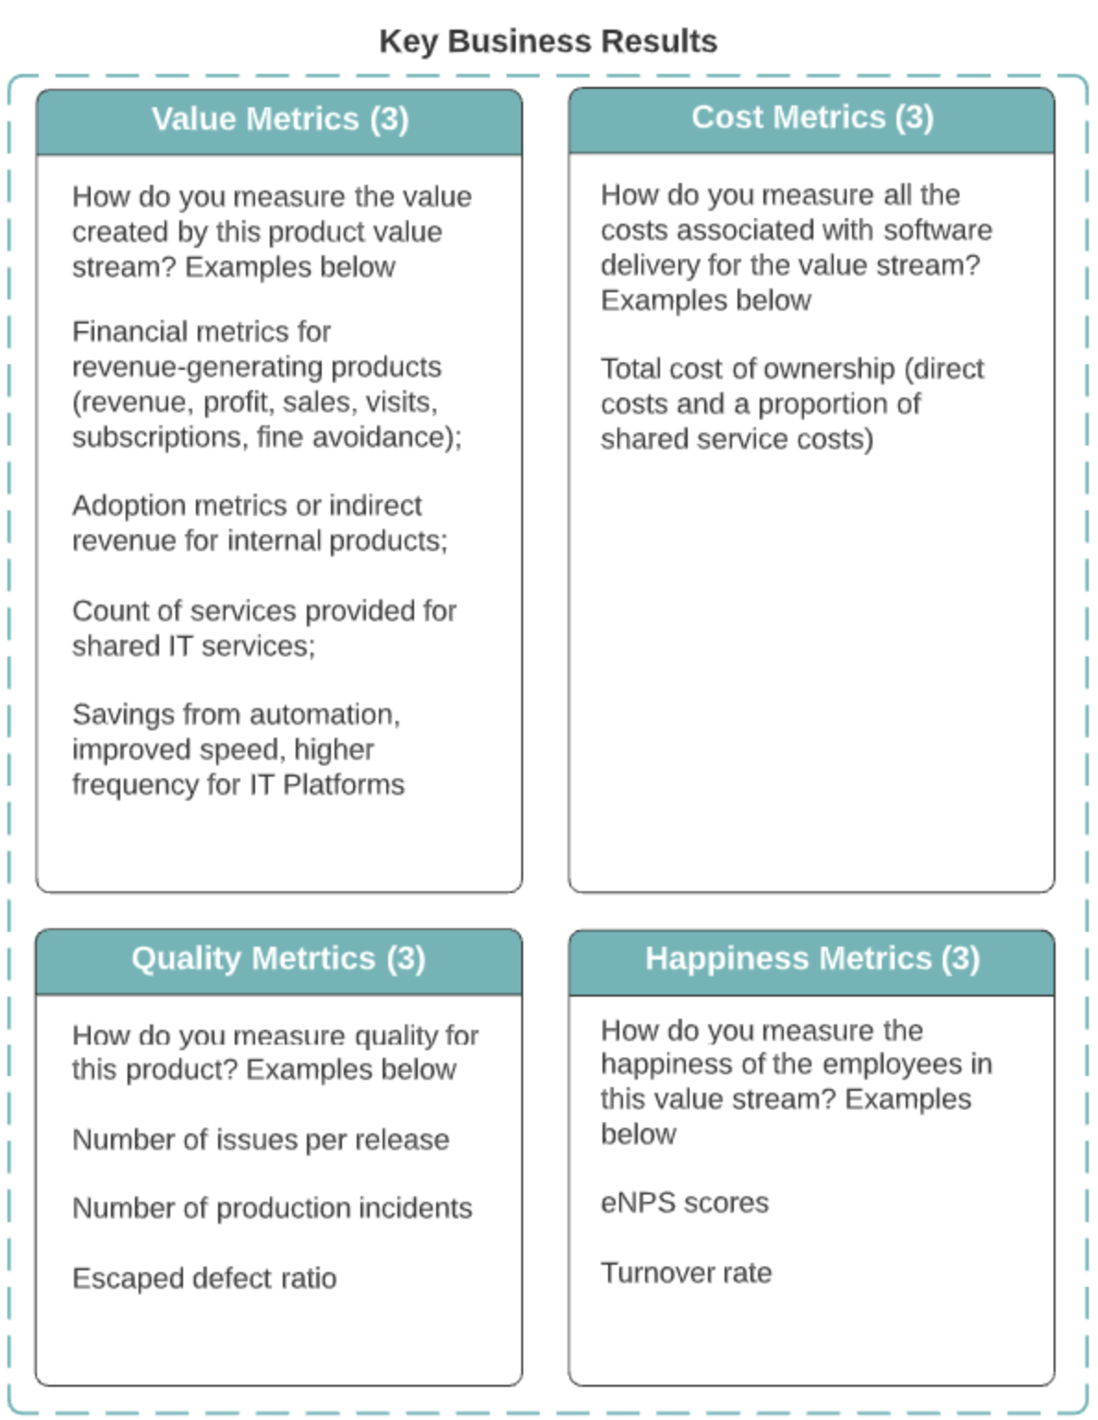
Value and Measure of Value
Product value stream
Its customer is identified
It produces a product
Its value is described
Notes:
By definition PVS – have a defined customer and produce a product - wich in turn makes it possible to describe value and measure them using key business results associated with them

Slide 18
Business Products
Internal Products
(Business / IT / Employee Focused)
Platform Products (IT for IT)
Business Products
External Customer
Mobile Banking App, Retail PoS System, Activity Tracker, Car Entertainment System
Billing System, Client Communications, HR Portal, Internal IT Portal
Internal Products
Internal Customer
IaaS, Delivery Pipeline,
Developer Tools
Platform Products
Developers
& Specialists

Slide 19
Business Products
Internal Products
(Business / IT / Employee Focused)
Platform Products (IT for IT)
Business Products
External Customer
Supporting Products
Standalone Products
Product capabilities utilized by multiple products
A building block of capabilities that developers can build on top of for a specific need
Can easily be consumed via an API
Capabilities consumed independently by internal customers, for example:
Internal procurement software
HR Systems
Content Management Systems
Internal Trading systems (for banks)
COTS
Internal Products
Internal Customer
Platform Products
Platform Products
Developers
& Specialists
Self-service technical capabilities consumed independently by product value streams when they need them:
Provisioning test environments
Creating deployment pipelines
Performance monitoring
Security testing
Database
Infrastructure
Notes:
Product Topologies
Product Topologies
You can break most applications and activity into Products.
Not all products need to be external facing. In fact a significant portion of products are internal

Slide 20
Who are My Customers and Influencers? Some Examples
 | Business Product E.g. Health Insurance | Internal Product E.g. Billing (shared service) | Platform Product E.g. DevOps Pipeline
Dictating value creation | Market, Business Strategy (all profitability concerns), CTO | Finance, External products that use it | Value Stream Architect on behalf of the software delivery organization
Dictating value protection | Regulation, Risk Officer, Legal | Regulation, Risk Officer, Legal | Regulation, Risk Officer
Prioritizing | Product Manager | Lisa in the finance department | Product Manager
Using | Consumers (in B2C), A particular department (in B2B) | Internal or Business products | IT practitioners
Paying | Business line | Continuous funding | Continuous funding
Supporting | Help Desk | Self | Self
Notes:
And by asking the right questions like who is using it , what purpose, how do they influence the work that is prioritized enable you to determine the right business outcomes for each product?

Slide 21
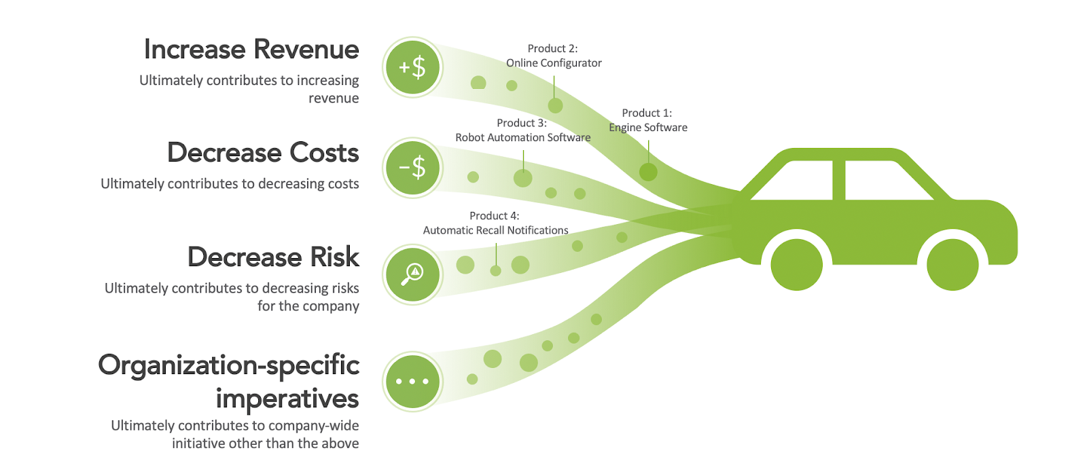
Value is mapped to top-level company concern
Example from an automotive manufacturer’s software product portfolio

Slide 22
Identify Impacts Business Outcomes
Revenue
# of Visits
Usage
# of API calls
Engagements provided
# FTE
TCO
Uptime
Escaped Defects
Customer NPS
Employee NPS
Turnover Rate
Notes:
Once you apply the business lens the desired business outcomes will co-relate to areas the business cares about the most and you can quantify the value they focus on.
So once you have some sense for what outcomes you need to optimize for, lets figure out what metrics can help align against them
There is shortage of metrics within software delivery – most dashboard can look like a Plane’s cockpit controls

Slide 23
Which view of an account do you prefer?
Notes:
Have a look at these 2 views of a bank account – which one do you prefer?
For me – if I am looking to figure out if I have enough to take out $2000, that 1st one is all I need.
If I need to make decisions on cutting my non-essential expenses, the 2nd is what I need to look for.
Metrics are no different. You need to align the level of details to the context.

Slide 24
Flow Metrics align the business and IT through a common understanding of value
FLOW METRICS
Measure the rate of value delivered for each product’s value stream, correlated with desired business outcomes
SOFTWARE DELIVERY METRICS
Measure the business outcomes themselves or siloed improvements in process, productivity, quality, cost, revenue or adherence to standards
Notes:
FMs help achieve predictability and higher efficiency
You have a lot of metrics to support and motivate whatever business practices you have today.
Where is that one dashboard that is overarching to make sure you are getting the bang for your buck.
So these are in addition.
Are we tying the output delivered as it relates to the business outcomes, and how do they correlate with cost, revenue, quality.
Flow Metrics are not the only thing you should measure.
They are required to put all the other metrics in perspective. Are the other metrics resulting in the right strategic investments.
These are summary metrics for a value stream.
Pick on story points which don’t mean anything to a C-Level person. Story points are always relative to the development team, it’s not about atomic features delivered which is most equivalent to value delivered.
FM Don’t focus on utilization of people, they observe the output. And use FE to point to potential points of improvement.
Microsoft example. Strategic alignment of your investment in your delivery, and rate of value delivery.
Flow Load – if you ratchet up that you’ll see a decrease in FV.
Flow Efficiency – instead of talking about story points, we’re giving you an efficiency metric that will point to hotspots for process improvement. Where are people actually wasting your time. Eliminate all the wait states in your process.
On a per product value stream basis to gauge efficiency and delivery of value, and the goal is to tie them to actual business results so you get a sense of how they correlate.
Paul’s point from DB.
Have a common language between me and the leadership.
One of the other points of these metrics is to establish predicability. You want to manage your organization towards consistency of these metrics so that you attain improvements but equally important is consistent predictable delivery

Slide 25
Different metrics for different contexts
FLOW METRICS
Overarching summary metrics for the value stream
Align to business outcomes resulting in strategic investments
Focused on predictability and efficiency
SOFTWARE DELIVERY METRICS
Metrics that measure day-to-day activities
Focus on capacity, utilization, team process improvements
Provide a deep-dive on outputs that impact outcomes

Slide 26
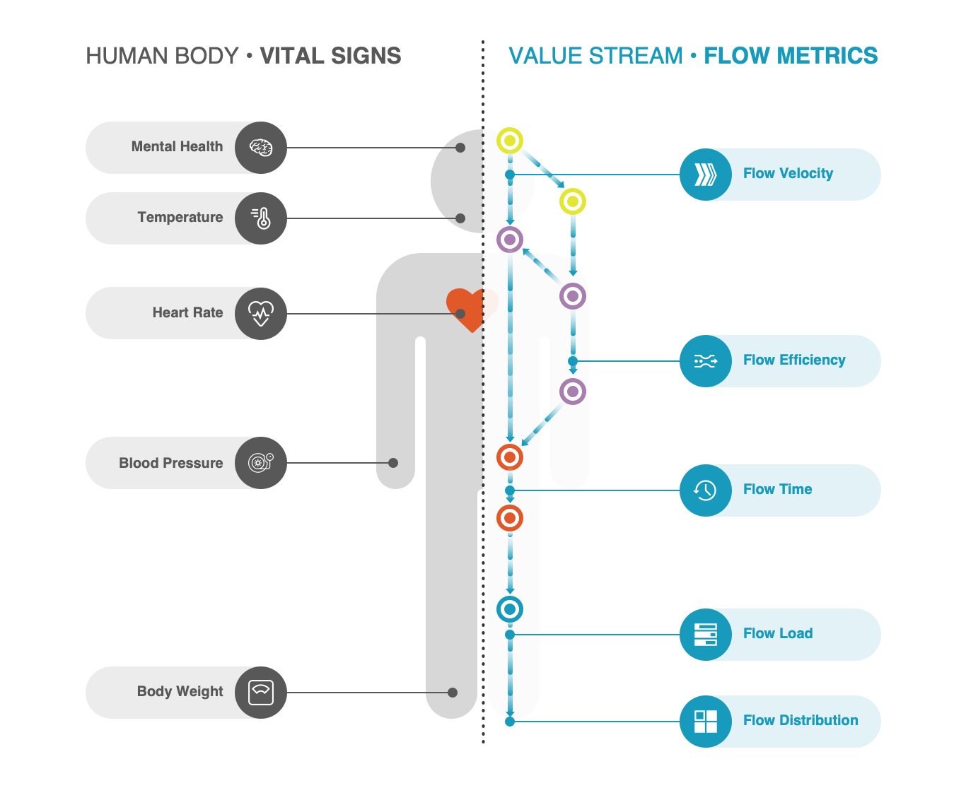
How much value is being delivered within a reporting period?
Are my processes causing teams to have to wait on work for significant periods of time?
How much time elapses from request to release?
Are teams thrashing because their incomings far outweigh their capacity to deliver?
Am I putting the right capacity towards features vs. risks vs. defects vs. debt?
© 2020 Tasktop

Slide 27
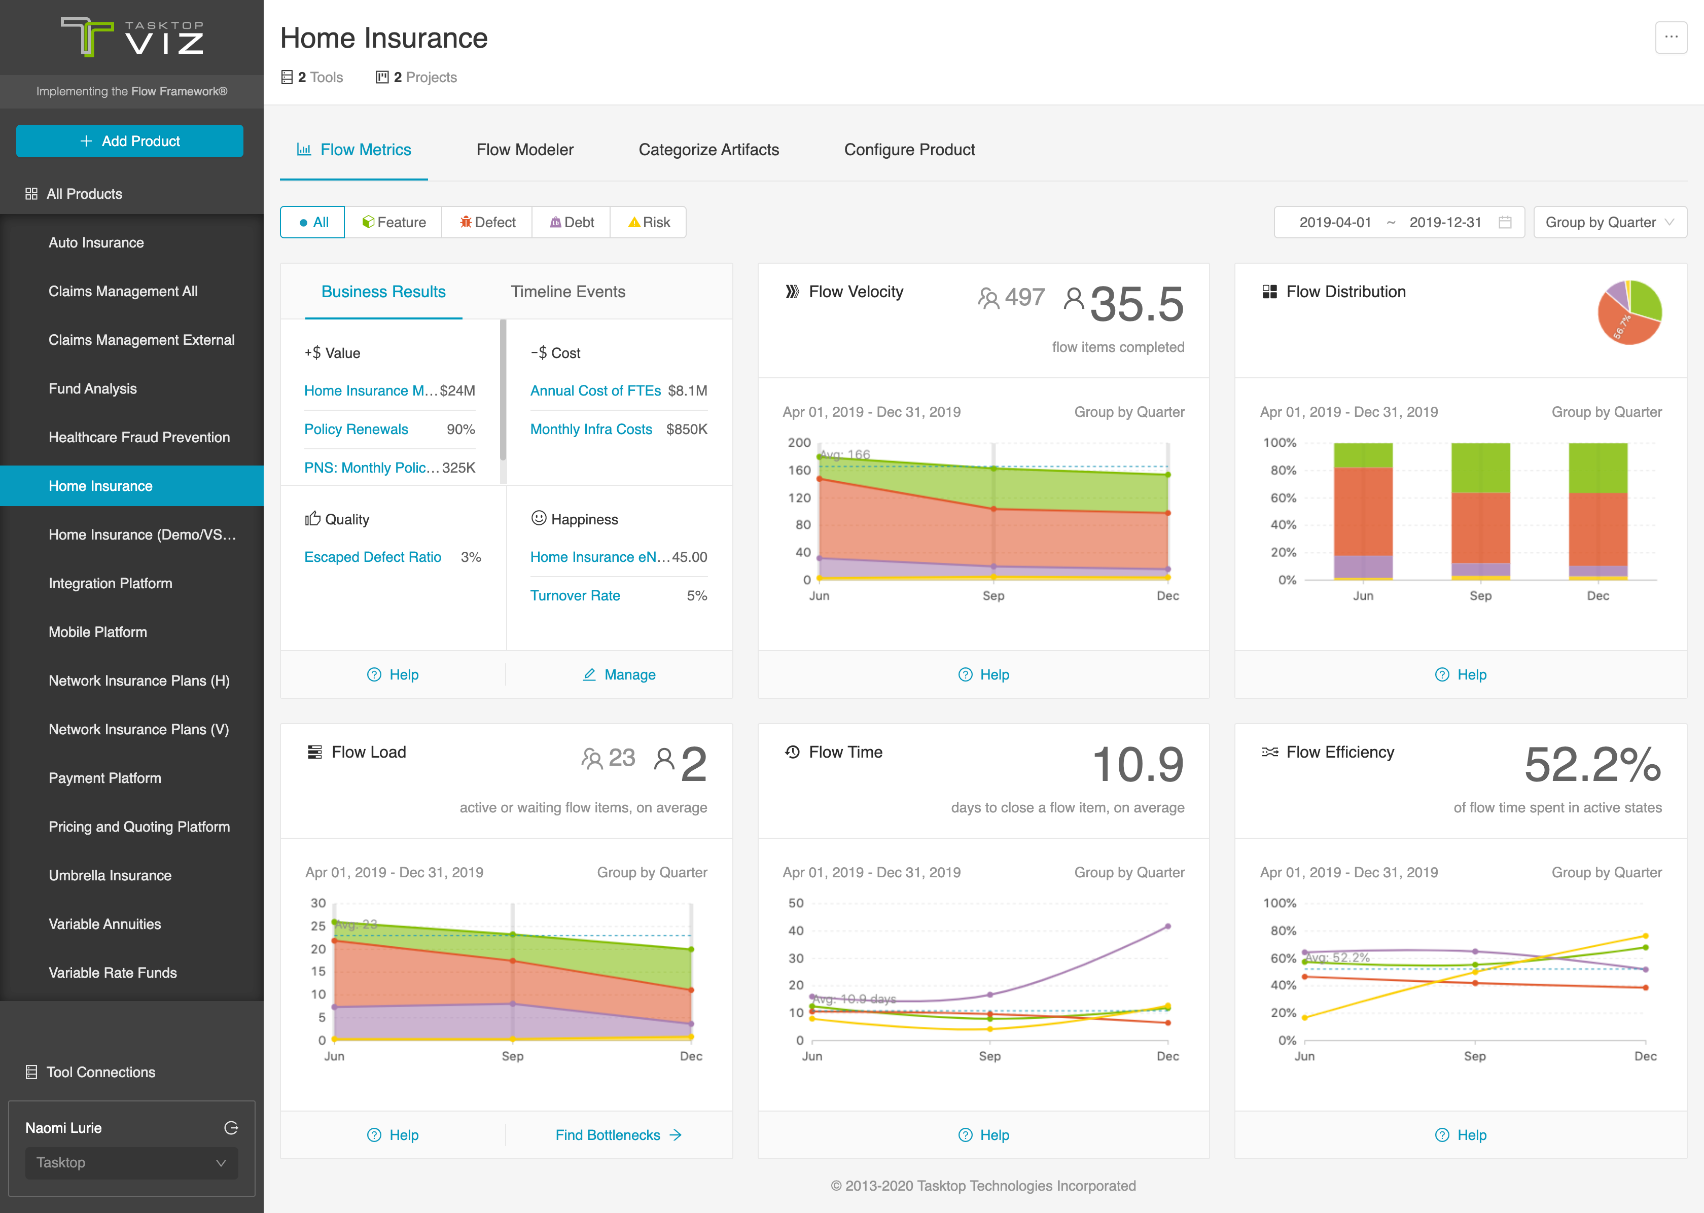
How much value is being delivered within a reporting period?
Am I putting the right capacity towards features vs. risks vs. defects vs. debt?
Are teams thrashing because their incomings far outweigh their capacity to deliver?
How much time elapses from request to release?
Are my processes causing teams to have to wait on work for significant periods of time?
Notes:
Business cares about Flow Velocity and Flow Time for Features; Flow Time on Defects
Flow Distribution is in service of Flow Velocity for Features and Risk Mitigation
Anchored in Business Results

Slide 28
How much value is being delivered within a reporting period?
Am I putting the right capacity towards features vs. risks vs. defects vs. debt?
Capture them real time
Are teams thrashing because their incomings far outweigh their capacity to deliver?
How much time elapses from request to release?
Are my processes causing teams to have to wait on work for significant periods of time?
Notes:
Business cares about Flow Velocity and Flow Time for Features; Flow Time on Defects
Flow Distribution is in service of Flow Velocity for Features and Risk Mitigation

Slide 29
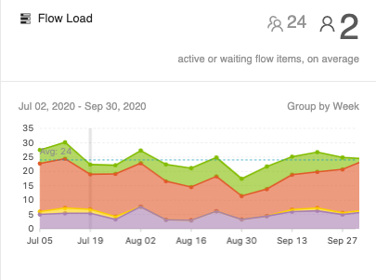
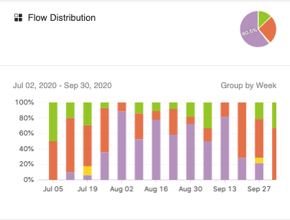
Why don’t Load and Distribution factor size of work?
Notes:
Just over a year ago we had to make a decision on one of our products to focus a whole Release on architectural change this meant that most of our capacity for the 6 week period was earmarked for debt work- with very little for any feature work

Slide 30
Quick Win day
(2 hr-8hr)
Architecture upgrade
Notes:
We use the little capacity we had on a collection of small features – 2-8hr efforts that have been in the backburner for a while through what we called the Quick Win days / Ship It days.
It enabled us to focus on Debt work and work through some of our backlog (many UI changes we had been putting off)

Slide 31
What customers saw
Quick Win day
(2 hr-8hr)
~ 50 feature items
Across all component
Architecture upgrade
Notes:
What the customers saw was a relase that included > 50 features (thought small but delightful and once they had been asking for a long time) And there was something for every customer!
This marked one of the high customer NPS period and our field teams were absolutely impressed to the point that we have now started including one of these days every 12 weeks.

Slide 32

Value does not always co-relate to size
Notes:
Lets take Tasktop for example

Slide 33
Prioritize what will impact Business Outcomes
# value units – features, risk, defects is a better guide if what thills customers than size of the work
You can only do 1 thing at a time – no matter the size
Notes:
Some would say this is gaming your metrics
Sure….but if leads to added benefit for the customer, do we care?

Slide 34
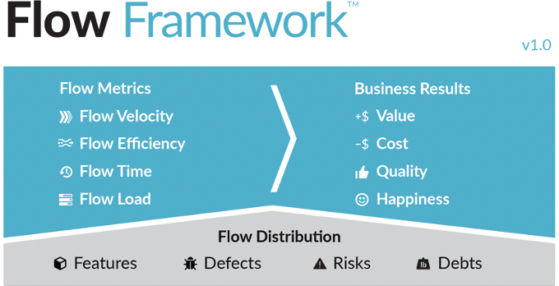
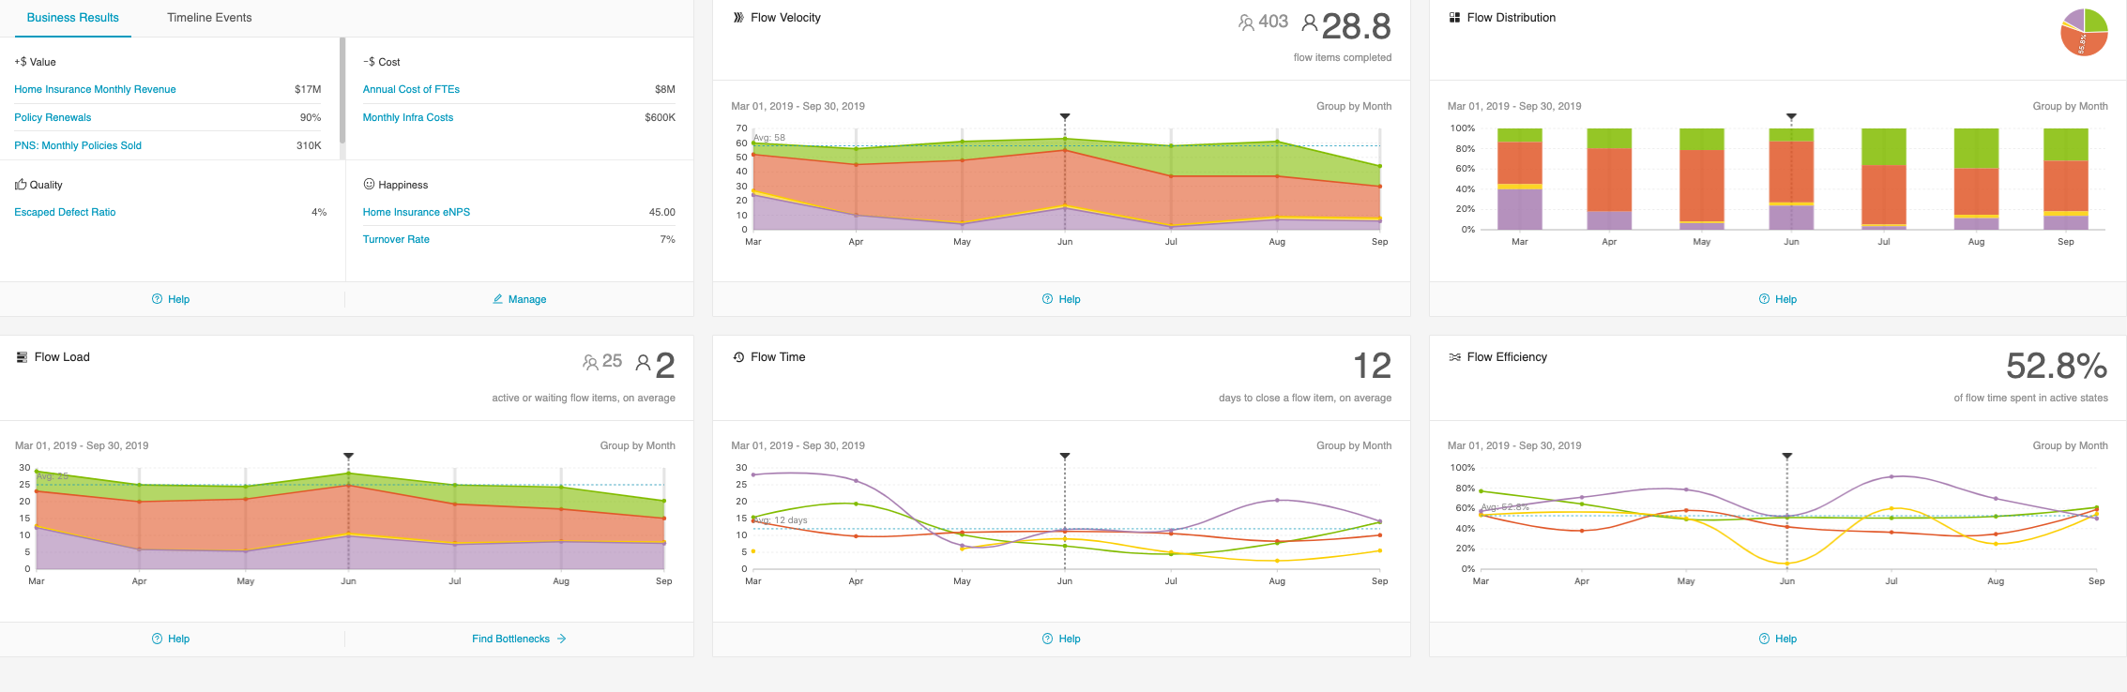
Which metric do we focus on?

Slide 35
Focus on Trends
There is no 1 metric to rule them all
Frequently review improvements against business results to demonstrate impact on right outcomes or pivot
Notes:
Going back to the initial example of Sam

Slide 36


Key Takeaways
Determine the Outcomes desired
Anchor metrics on Business Results
Leverage Flow Metrics to business visibility
01
02
03
Value does not always co-related to Size
Focus on Trends
04
05

Slide 37
